Slide 1
Fundamentals of Web Development
JavaScript Day III
Additional Features and frameworks

Slide 2
In this chapter you will learn . . .
Additional language features in JavaScript
Extend the capabilities of APIs
Utilize external APIs for mapping and charting
JS library and frameworks

Slide 3
Display Data from Array
Demo : Movie Data from Array

Slide 4
Json Data
Question _How does the Json data being displayed in HTML?
https://codepen.io/franverona/pen/yPZzjy

Slide 5
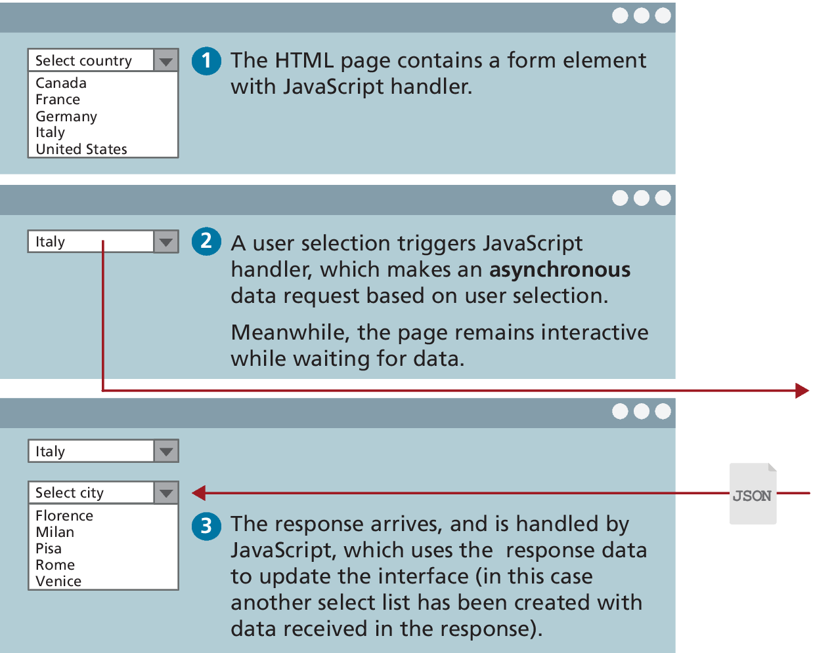
Fetching Data from a Web API
To illustrate fetch, consider the scenario of a page containing a <select> element.
When the user selects from the country list, the page makes an asynchronous request to retrieve a list of cities for that country.
let cities = fetch('/api/cities.php?country=italy');

Slide 6
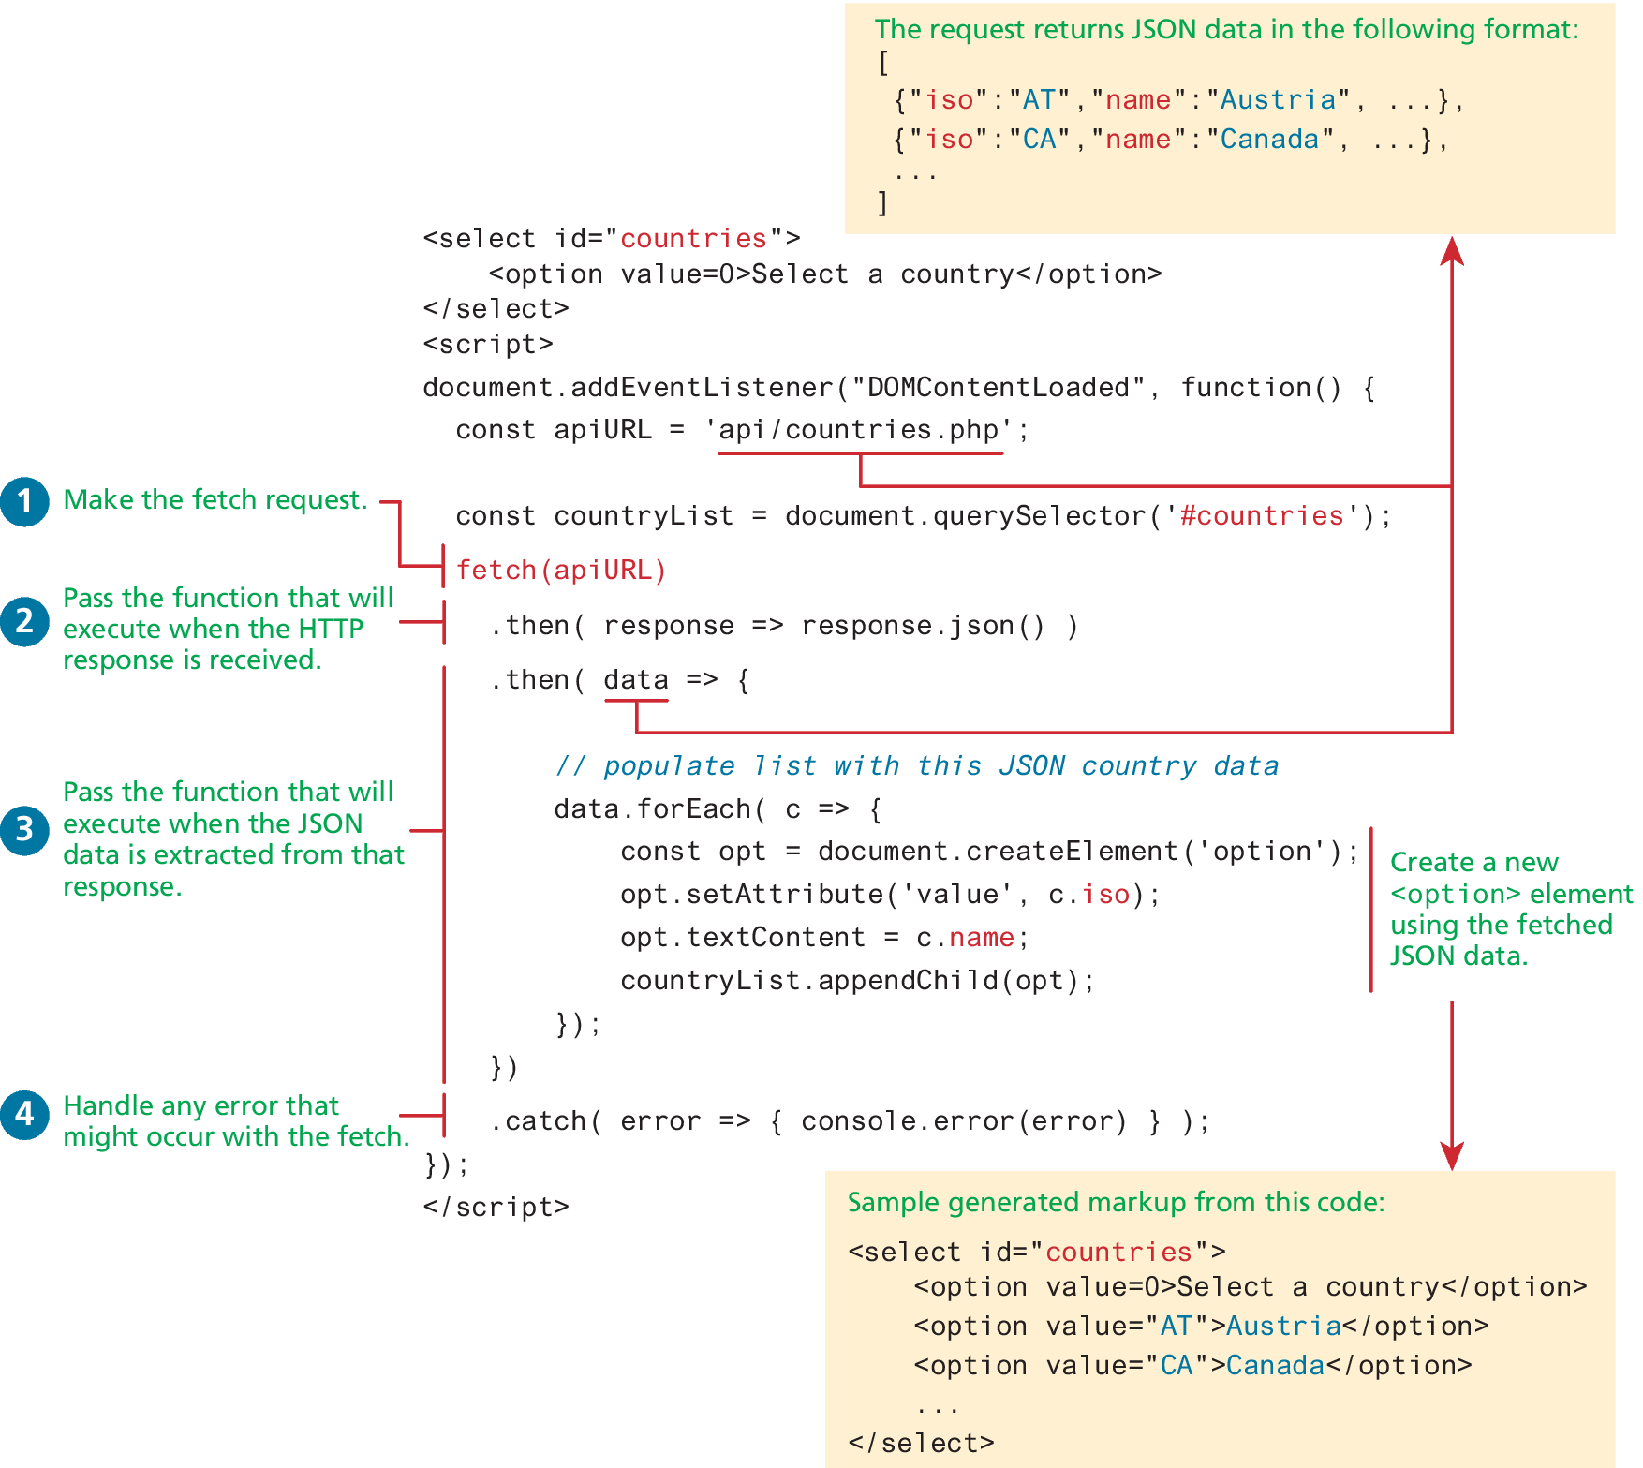
Example of request using fetch

Slide 7
Fetch API example
https://codepen.io/Sestri4kina/pen/peNayz

Slide 8
Web Storage API
The Web Storage API provides a mechanism for preserving non-essential state across requests and even across sessions. It comes in two varieties:
localStorage is a dictionary of strings that lasts until removed from the browser.
sessionStorage is also a dictionary of strings but only lasts as long as the browsing session.
To add a string to either involves calling the setItem() method of the localStorage or sessionStorage objects.
To retrieve a value from either simply requires using the getItem() method.

Slide 9
Web Storage API (ii)
The Web Storage API provides a mechanism for preserving non-essential state across requests and even across sessions. It comes in two varieties:
localStorage is a dictionary of strings that lasts until removed from the browser.
To add a string to either involves calling the setItem() method of the localStorage or sessionStorage objects.
To retrieve a value from either simply requires using the getItem() method.

Slide 10
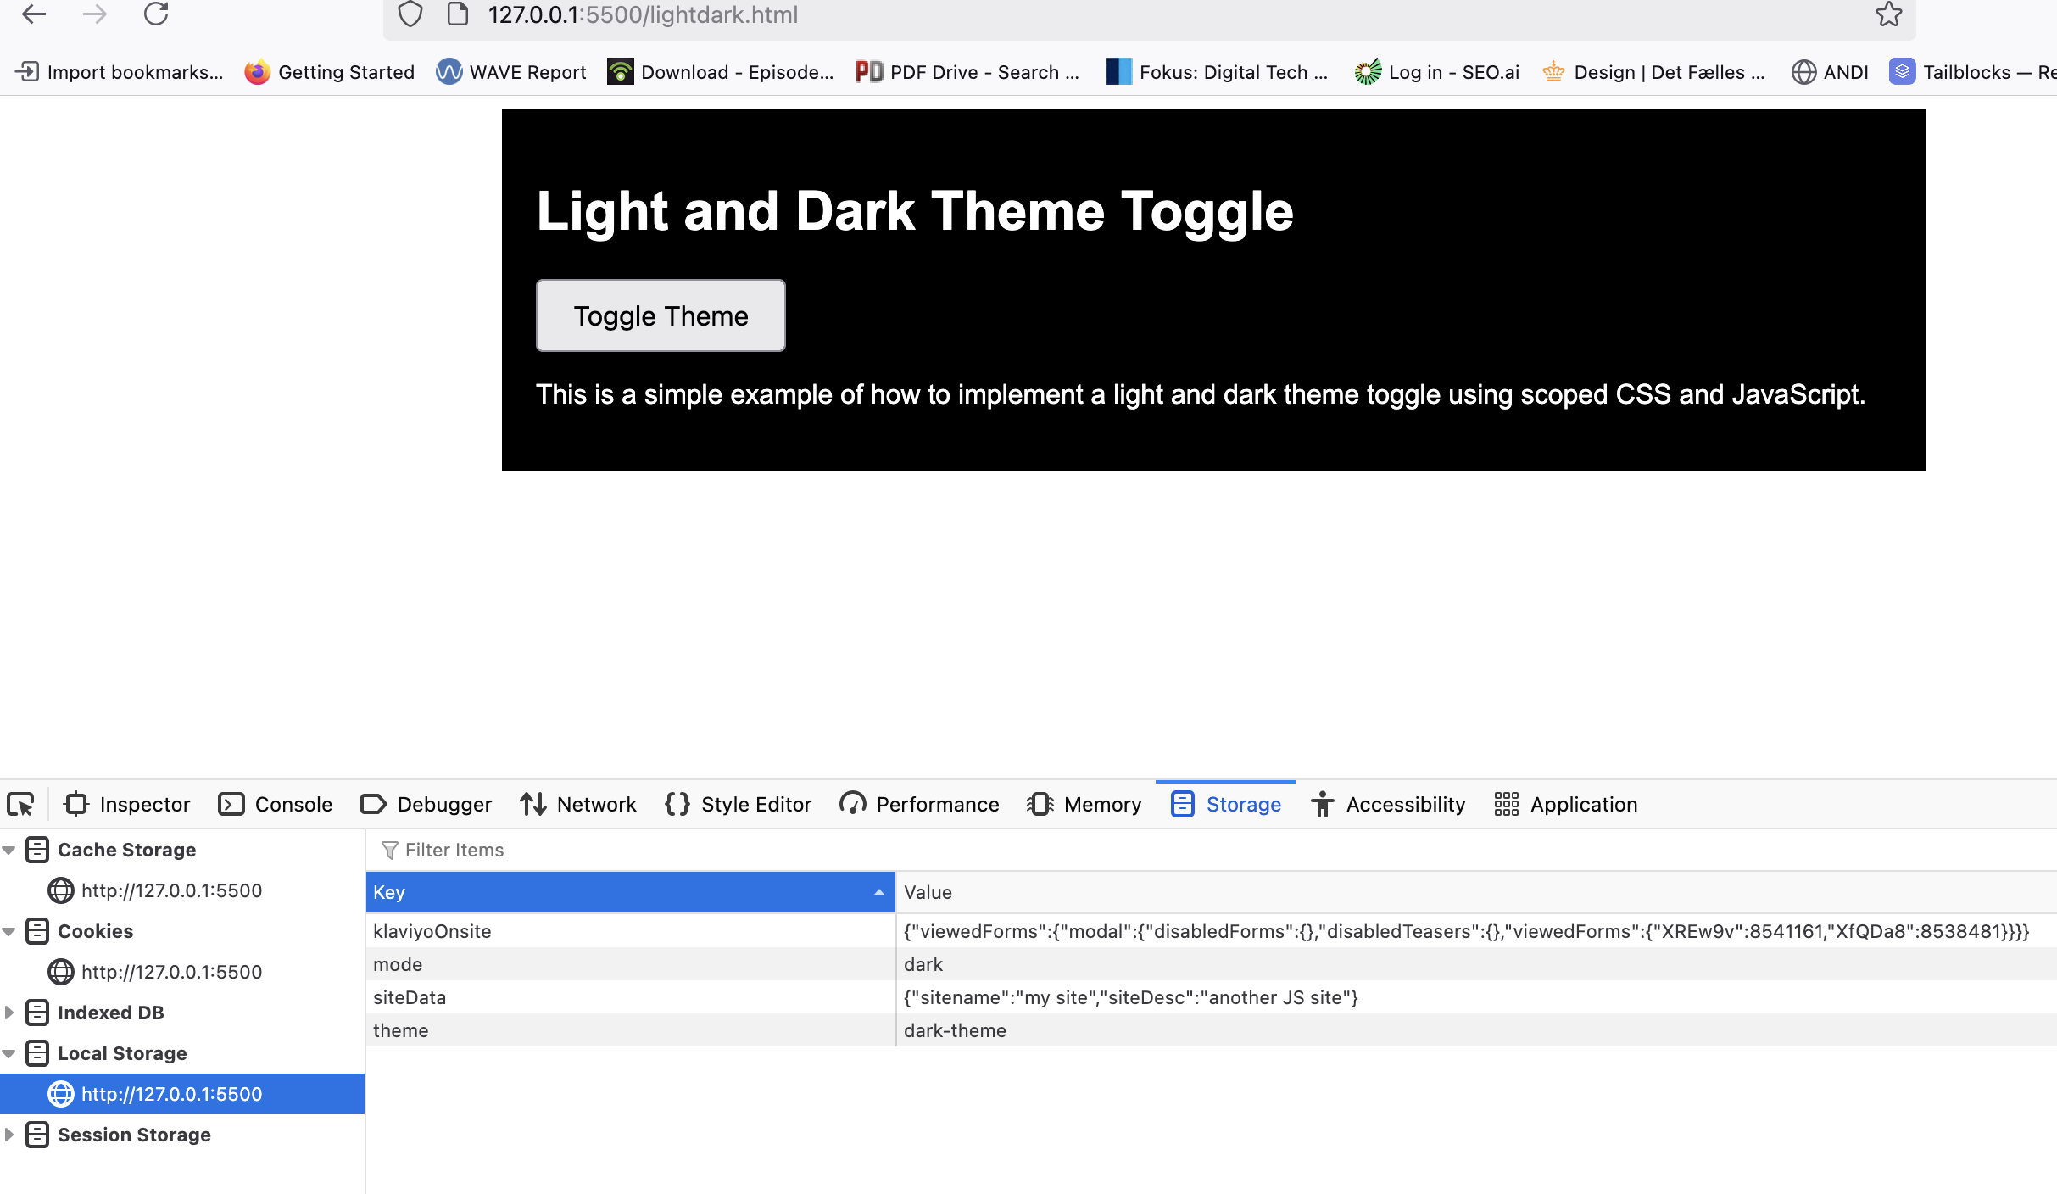
Dark mode with local storage
demo

Slide 11
JS library

Slide 12
Google Chart library

Slide 13
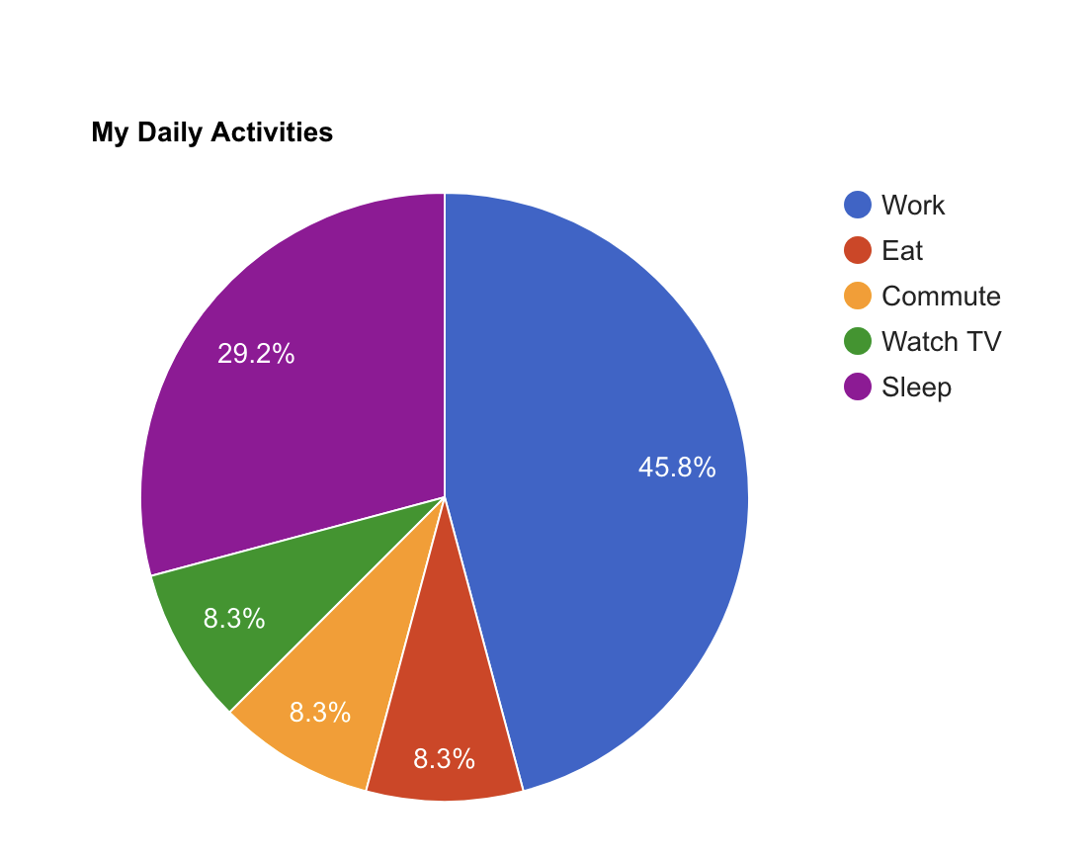
Charting with Google
google.charts.load('current', {'packages':['corechart']});
google.charts.setOnLoadCallback(drawChart);
function drawChart() {
var data = google.visualization.arrayToDataTable([
['Task', 'Hours per Day'],
['Work', 11],
['Eat', 2],
['Commute', 2],
['Watch TV', 2],
['Sleep', 7]
]);
var options = {
title: 'My Daily Activities'
};
var chart = new google.visualization.PieChart(document.getElementById('piechart'));
chart.draw(data, options);
}

Slide 14
Other JS library

Slide 15
lightBox2
https://koder.systime.dk/?id=138&L=1#c571
This library has dependency on JQuery

Slide 16
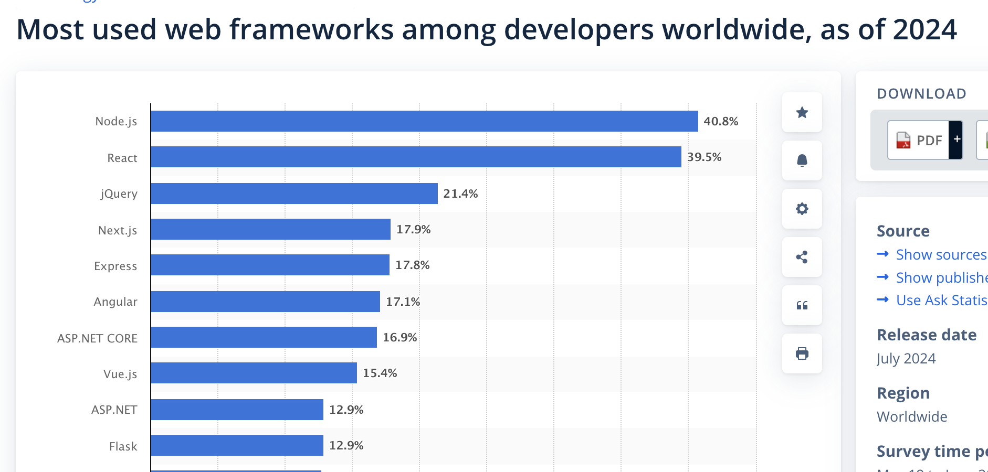
JS framework
https://www.statista.com/statistics/1124699/worldwide-developer-survey-most-used-frameworks-web/

Slide 17
JQuery
https://codepen.io/bessa/pen/ORNBxJ
Source https://jquery.com/

Slide 18
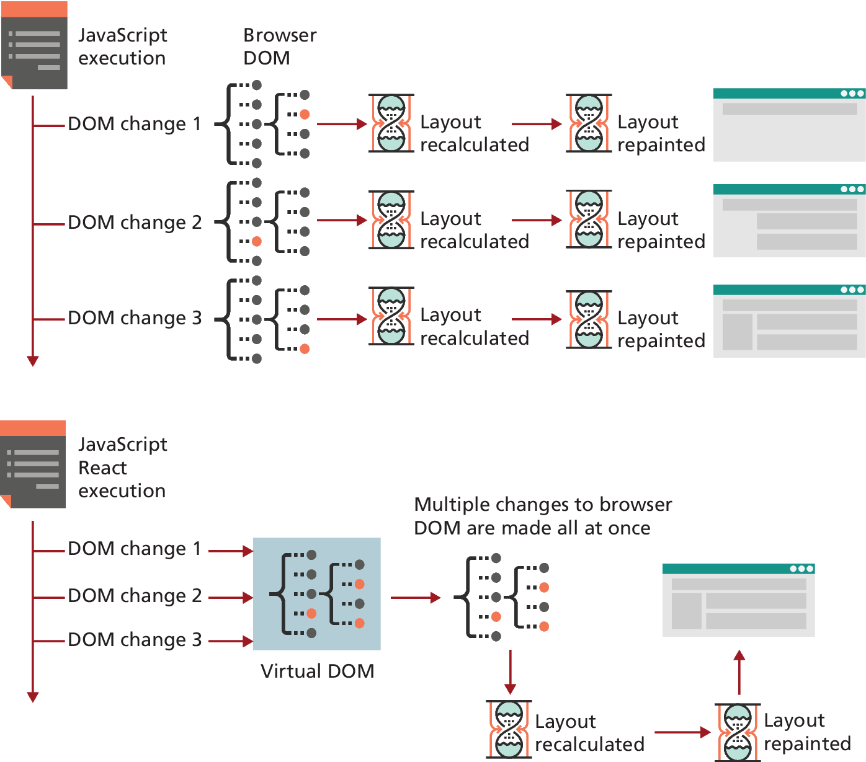
Why Do We Need Frameworks?
Ideally a framework, simplifies the process of creating user interfaces.
React has a virtual DOM that your code manipulates, improving the execution speed of DOM manipulation.

Slide 19
React, Angular, and Vue
Angular is an “opinionated” framework in that it forces developers to adopt a known and well-regarded approach to structuring and implementing a web application.
The React framework from Facebook is now the most popular JavaScript Framework today for constructing complex front-ends in JavaScript
Vue.js is similar to React in that it focuses on the view. While React uses its own JSX syntax that allows the developer to “inject” HTML into the JavaScript, Vue.js uses HTML templates with data and behavior “injected” via custom attributes and directives. Vue.js is fully open-source
All three frameworks are especially well suited to constructing a Single-Page Application (SPA).

Slide 20
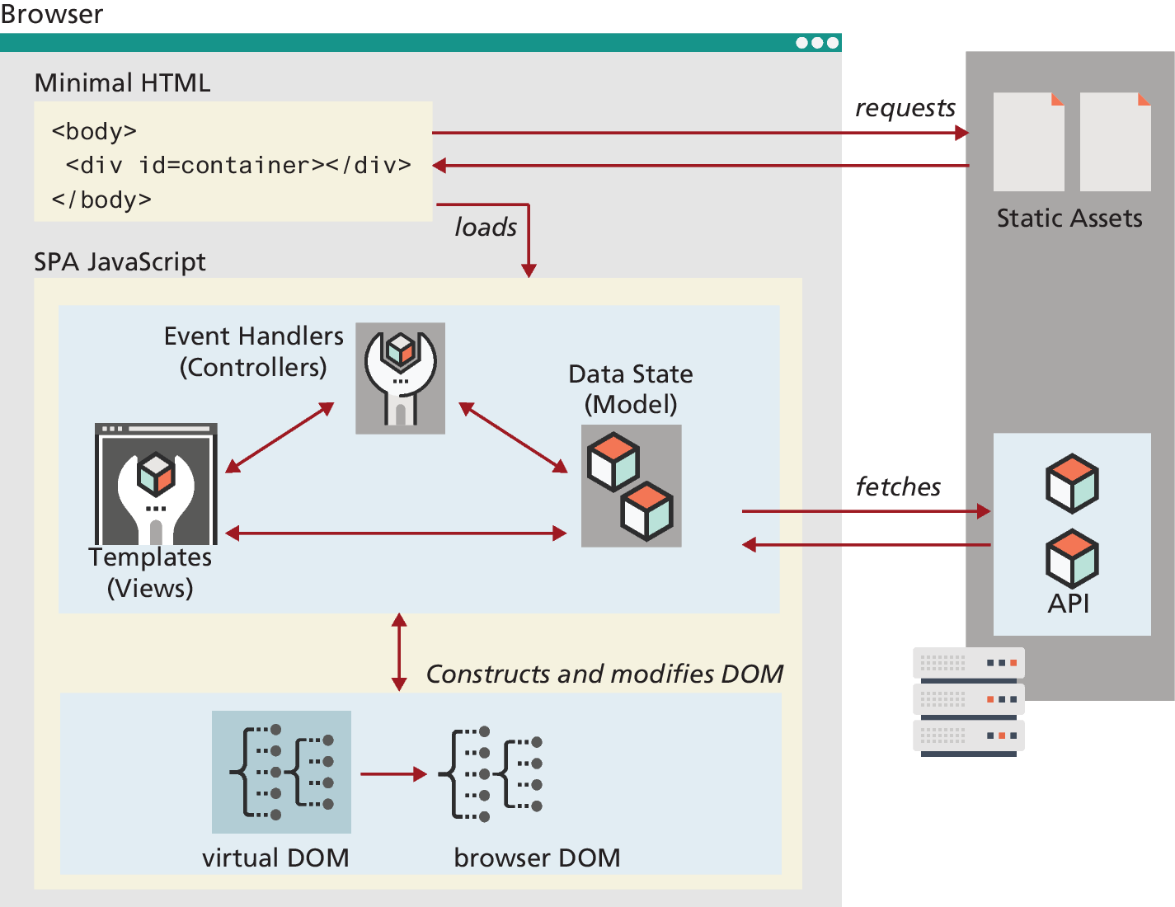
Single Page Applicaiton
An SPA constructed with a framework typically contains minimal HTML. Instead, JavaScript is used to populate the DOM with HTML elements using logic contained within the framework and data pulled from some API

Slide 21
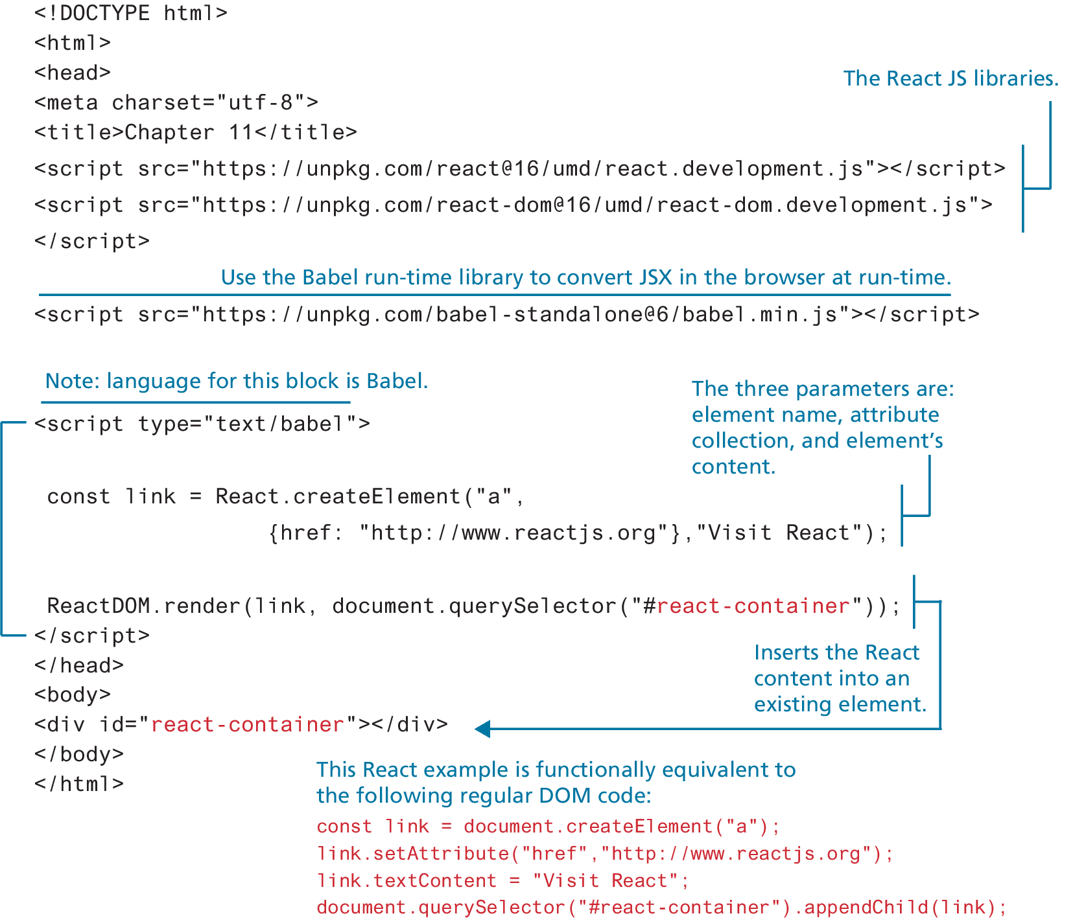
Introducing React

Slide 22
React Demo
https://codepen.io/mercuryworks/pen/EyQaBO

Slide 23
reference
Aguko. (2025, February). JavaScript Frameworks Market Share. Retrieved from https://www.aguko.com/cat/javascript-frameworks
• ELITEX. (2025). Most Popular JavaScript Frameworks: A Full Guide for 2025. Retrieved from https://elitex.systems/blog/most-popular-javascript-frameworks/
• Statista. (2024). Most used web frameworks among developers worldwide. Retrieved from https://www.statista.com/statistics/1124699/worldwide-developer-survey-most-used-frameworks-web/

